Slide 1
Microservices made easy with MicroProfile and Open Liberty Jamie L Coleman Software Engineer/Advocate

Slide 2
Why move to the Cloud?
Think London / October 16th, 2019 / © 2019 IBM Corporation

Slide 3
What the Cloud offers
Demand
One big server running all the time?
time

Slide 4
What the Cloud offers
Demand
One big server running all the time?
time

Slide 5
What the Cloud offers
Demand
One big server running all the time?
time

Slide 6
What the Cloud offers
Demand
SAVE ENERGY
SAVE MONEY
One big server running all the time?
time

Slide 7
Eclipse MicroProfile

Slide 8

What is MicroProfile?
Eclipse MicroProfile is an open-source community specification for Enterprise Java microservices
A community of individuals, organizations, and vendors collaborating within an open source (Eclipse) project to bring microservices to the Enterprise Java community
microprofile.io

Slide 9













MicroProfile Contributors
Think London / October 16th, 2019 / © 2019 IBM Corporation
9

Slide 10

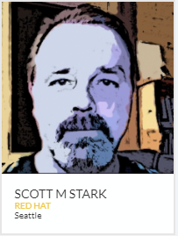
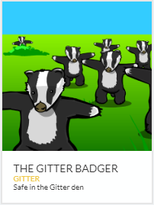
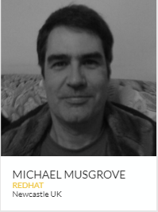

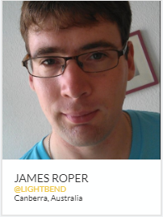

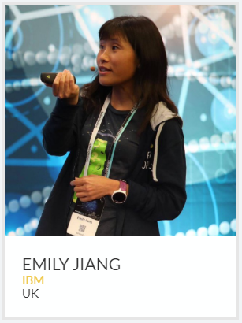
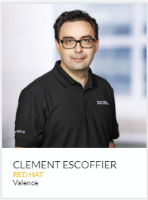
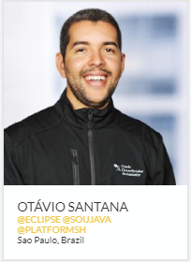

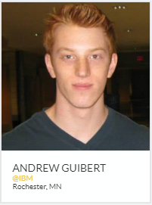



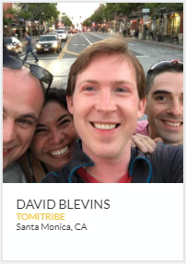

MicroProfile Community
Over a dozen vendors and Java user groups
140 individual contributors
Over half a dozen independent implementations

Slide 11
Locations of some MicroProfile Contributors
Source: MicroProfile.io
Seattle – USA
Ontario – Canada
Canberra – Australia
Stuttgart – Germany
Rochester – USA
Prague – Czech Rep
Newcastle – UK
Munich – Germany
Paris – France
Hursley – UK
Centurion – South Africa
Boston – USA
Sao Paulo – Brazil
Rio de Janeiro – Brazil
Coimbra – Portugal
Amsterdam – Netherlands
Think London / October 16th, 2019 / © 2019 IBM Corporation
Notes:
Master Draft 1
Master Draft 1
11

Slide 12

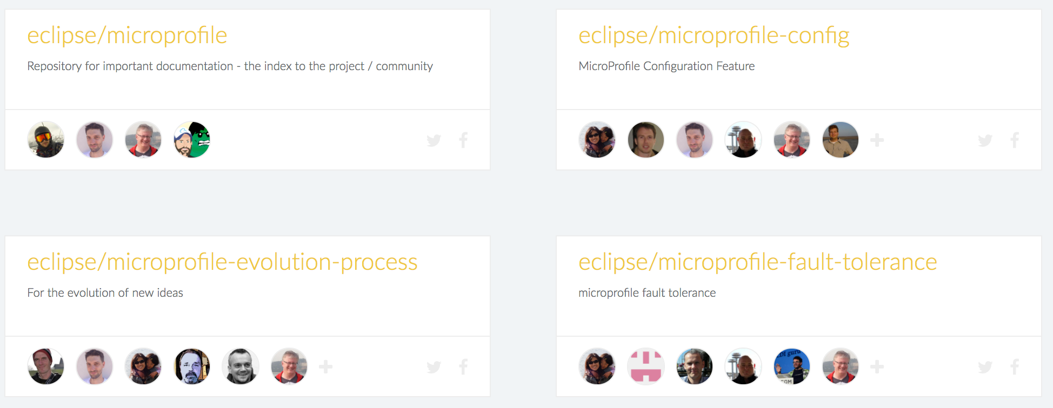



MicroProfile Community
Google Groups
MicroProfile Projects
Bi-Weekly & Quarterly
General community
Meetings
Video Hangouts
YouTube Channel

Slide 13








MicroProfile Vendors/Implementations
Think London / October 16th, 2019 / © 2019 IBM Corporation
13

Slide 14
MicroProfile Technologies

Slide 15
MicroProfile 3.0 Stack
Open Tracing 1.3
Health Check 2.0
Metrics 2.0
Open API 1.1
Fault Tolerance 2.0
JWT Propagation 1.1
Config 1.3
JAX-RS 2.1
CDI 2.0
JSON-P 1.1
JSON-B 1.0
Rest Client 1.3

Slide 16

MicroProfile 3.0 Stack
Open Tracing 1.3
Health Check 2.0
Metrics 2.0
Open API 1.1
Fault Tolerance 2.0
JWT Propagation 1.1
Config 1.3
JAX-RS 2.1
CDI 2.0
JSON-P 1.1
JSON-B 1.0
Rest Client 1.3

Slide 17
MicroProfile Core Technologies
Fault Tolerance
@Retry(retryOn = TimeoutException.class,
maxRetries = 4,
maxDuration = 10,
durationUnit = ChronoUnit.SECONDS)
public void startCoffeeBrew(CoffeeBrew brew) {
Response response = baristaClient.startCoffeeBrew(brew);
...
}
A
B

Slide 18
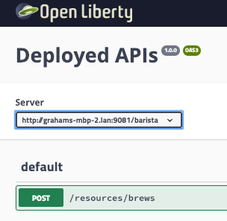
MicroProfile Core Technologies
Open API
openapi: 3.0.0
info:
title: Deployed APIs
version: 1.0.0
servers:
- url: http://grahams-mbp-2.lan:9081/barista
paths:
/resources/brews:
post:
operationId: startCoffeeBrew
requestBody:
content:
application/json:
schema:
$ref: '#/components/schemas/CoffeeBrew'
responses:
default:
description: default response
A
B
components:
schemas:
CoffeeBrew:
type: object
properties:
type:
type: string
enum:
- ESPRESSO
- LATTE
- POUR_OVER

Slide 19
MicroProfile Core Technologies
Config
A
B
@ApplicationScoped
public class Barista {
@Inject
@ConfigProperty(name="default_barista_base_url")
String baristaBaseURL;
... }

Slide 20
MicroProfile Core Technologies
Metrics
A
B
@POST
@Counted(name="order", displayName="Order count",
description="Number of times orders requested.", monotonic=true)
public Response orderCoffee(@Valid @NotNull CoffeeOrder order) {
...
}

Slide 21
MicroProfile with Kubernetes
Health
readinessProbe:
httpGet:
path: /health
port: 9080
initialDelaySeconds: 15
periodSeconds: 5
failureThreshold: 1
A
B

Slide 22
MicroProfile 3.0 Stack
Reactive Streams Operators 1.1
GraphQL 1.0
Reactive Messaging 1.0
Standalone Projects
Context Propagation 1.0
Open Tracing 1.3
Health Check 2.0
Metrics 2.0
Open API 1.1
Fault Tolerance 2.0
JWT Propagation 1.1
Config 1.3
JAX-RS 2.1
CDI 2.0
JSON-P 1.1
JSON-B 1.0
Rest Client 1.3

Slide 23
Containers & Kubernetes

Slide 24
MicroProfile & Containers
Containers
Kubernetes
Istio
Open Tracing 1.3
Health Check 2.0
Metrics 2.0
Open API 1.1
Fault Tolerance 2.0
JWT Propagation 1.1
Config 1.3
JAX-RS 2.1
CDI 2.0
JSON-P 1.1
JSON-B 1.0
Rest Client 1.3

Slide 25

Containers
build, ship and run any app, anywhere
docker build -t ol-runtime --no-cache=true .
docker run -d --name rest-app -p 9080:9080 -p 9443:9443 -v <absolute path to guide>/start/target/liberty/wlp/usr/servers:/servers ol-runtime

Slide 26
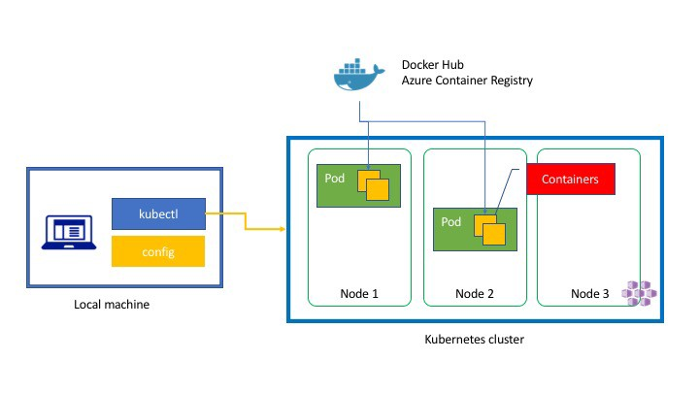
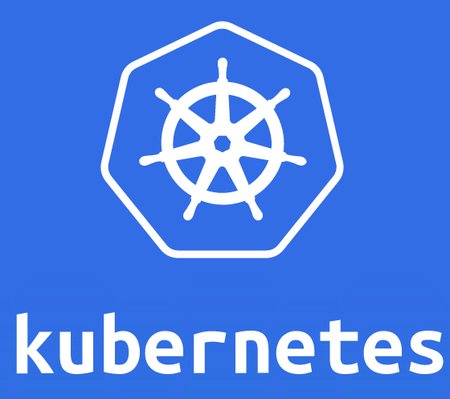
Kubernetes
build, ship and run any app, anywhere

Slide 27
A Full Open Stack

Slide 28


A Full Open Stack MicroProfile Open Liberty OpenJ9

Slide 29
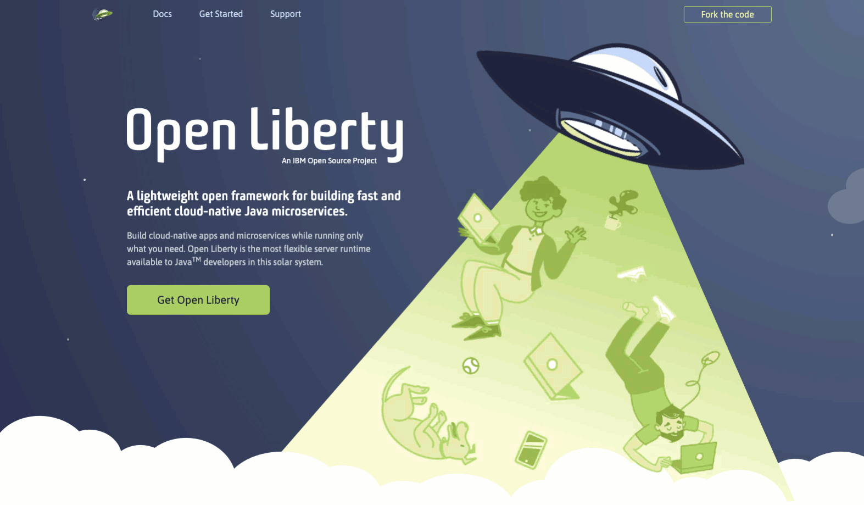

Slide 30
Open Liberty Overview

Slide 31
Open J9 Overview
Designed from the start to span all the operating systems needed by IBM products
This JVM can go from small to large
Can handle constrained environments or memory rich ones
Is used by the largest enterprises on the planet
If any JVM can be said to be at the heart of the enterprise – its this one.

Slide 32
Recap
All Open Source!
MicroProfile
No vendor lock in
Full set of cloud ready APIs
Config
Health
Metrics
Fault Tolerance
Big community
Open Liberty
Modular Application server
Light weight
Easy to configure
Jakarta EE 8 certified
Production ready
Official Docker images available
Open J9
Low memory footprint
Fast startup time
High application throughput
Smoother ramp-up in the cloud
Easy to use Docker images

Slide 33
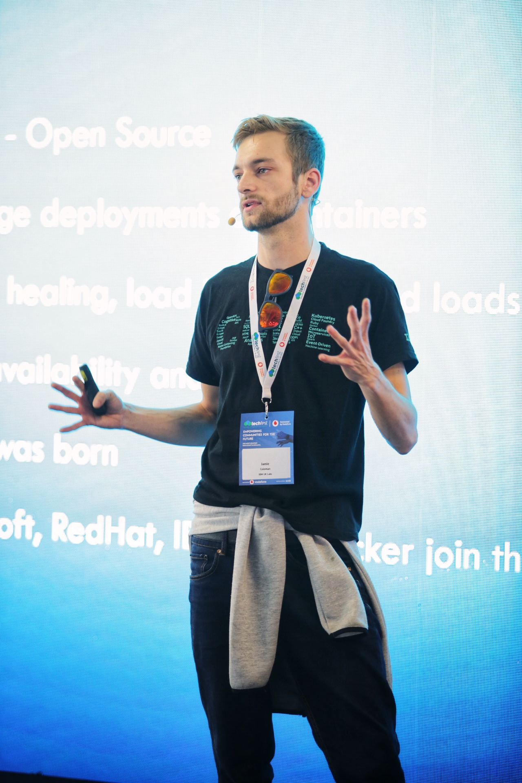
Thank you
Jamie Lee Coleman
Software Engineer/Advocate
Email: jlcoleman@uk.ibm.com
Twitter: @Jamie_Lee_C

Slide 34
Time
To
Code
https://github.com/jamiecoleman92/microservices-made-easy

